Slide 1



Expressly created for:
16767 N Perimeter Dr. Suite 230
Scottsdale, Arizona 85260
Date: September 25, 2020
Proposal valid for 60 days

Slide 2

Letter From The CEO
Thank you for the opportunity to respond to the HonorHealth Foundation New Website Design & Development RFP. We recognize the importance of your digital presence, and the significant decision you face in choosing a long-term partner.
We certainly hope that you will find our response compelling. We hope that we have the opportunity to co-create and execute a world-class digital presence, that you will truly be proud of. We are grateful for your consideration.
Regards,
Trish Bear
CEO and President, I-ology
2

Slide 3

Contents
Why I-ology
A Partner you Can Count on
The Digital Foundation
Strong Technology is at the Core - Phase 1
How We Get There
A Solid & Strategic Process
What Will It Take
Implementation & Investment
The Big Picture
Build for Today, Plan for the Future
Supplemental Information / Vendor Question Responses
RFP Q&A
3

Slide 4

Why I-ology
A Partner You Can Count On
4

Slide 5


We are Values Driven
Responsiveness: We focus on high quality responsiveness so we earn your trust at every level.
Passion: We are passionate about driving success you can measure. We will be a team you can count on.
Integrity: We are honest, accountable, and committed. We do what we say we will and keep your best interest in mind.
Excellence: We strive for excellence in all that we do and how we do it.
5

Slide 6
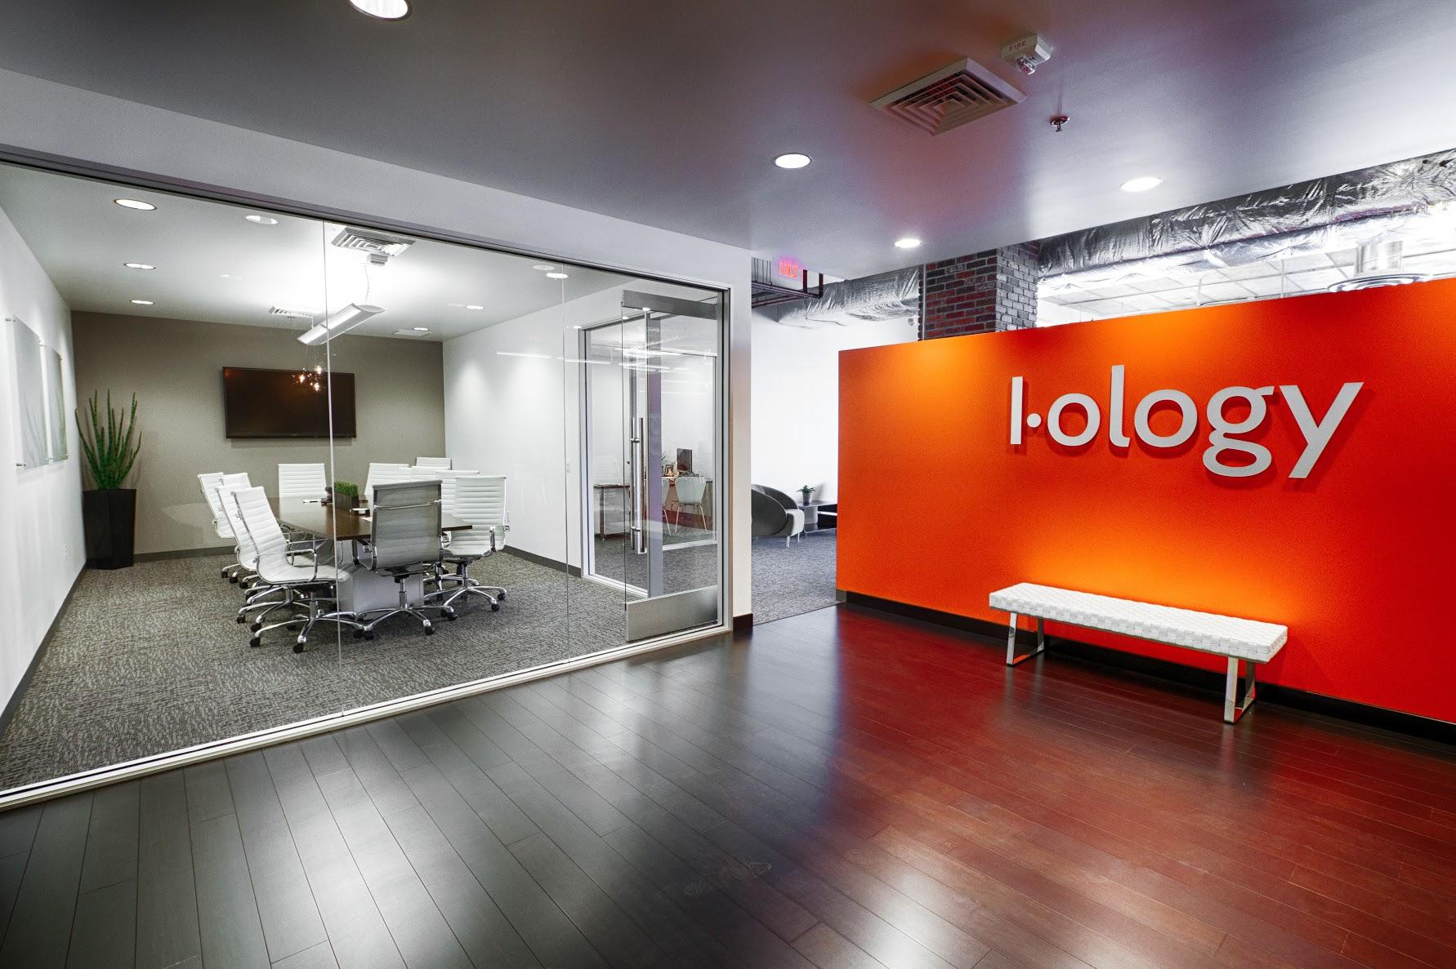



A Partner with Experience & Accolades
I-ology is a boutique digital transformation consulting and delivery firm. We enhance business capabilities by identifying market opportunities and delivering custom digital solutions that align to those opportunities.
Comprised of digital subject matter experts
20 years of driving comprehensive digital strategies
Highly responsive team
Extension of internal team
Healthcare vertical expertise
6

Slide 7
Digital Landscape Differentiator
Traditional Ad Agency
Digital Marketing Agency
Digital Transformation Agency
Develops creative plans for advertising & promotion.
Develops & implements digital marketing campaigns to reach target audiences.
Uses digital technologies to create new or modify existing - business process, culture, and customer experiences.
Brand Development
Graphic Design
Media Buying
Public Relations
Web Design (ie: WordPress)
SEO
Digital Content Creation
Social Media/Public Relations
Reputation Management
Web Design (ie: WordPress)
Experience Design
Full Stack Development and Integration
Cloud Migration and Integration
Application Development
Web Development
(Inter-relational CMS)
7

Slide 8



A Partner Focused on Digital Expertise
Digital Discovery & User Research
User Interface & Visual Design
Front-End Engineering
Content Management System Deployment & Customization
Platform Integration
Experience Innovation
Managed Hosting Services
Digital Marketing Consulting
8

Slide 9








A Partner with Proven Experience
9

Slide 10

The Digital Foundation
Strong Technology is at the Core - Phase I
10

Slide 11







Technology Exists for People
I-ology will work with HonorHealth Foundation to further identify the user journeys for each persona and how they can best be served. Co-creating those journeys will provide the opportunity to leverage digital technologies while creating a seamless experience for all of your target audiences.
Current Donors
External Foundations’ Leadership and Staff
Governance
Donor Prospects
HonorHealth Employees
Volunteers
Additional Stakeholders
11

Slide 12
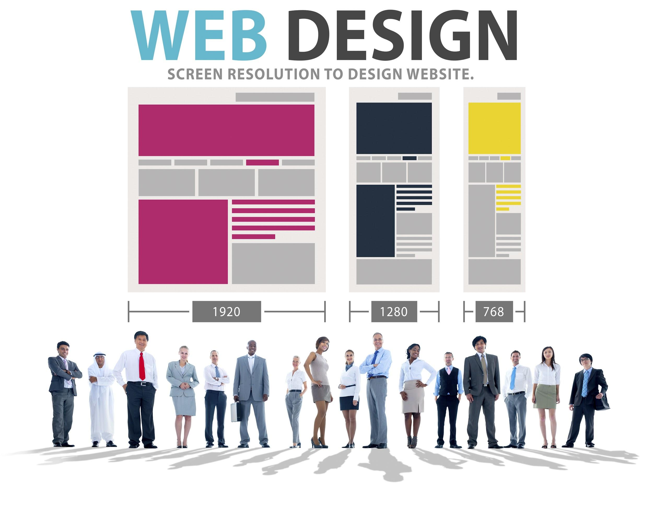
Design with a Mobile-First Strategy
I-ology focuses on a customer-centric experience that encourages personas to accomplish their objectives. To achieve the solution, I-ology will:
Design for mobile
Optimize desktop real estate and responsiveness
Promote clear Calls-to-Action (CTA)
Incorporate new branding
12

Slide 13
Build for User Engagement & Ease of Use
Engagement starts at site structure and content organization. Through collaboration, the existing content will be refined, consolidated, and SEO optimized to:
Improve usability
Serve all personas
Promote engagement and loyalty
Home
Site Search
Persistent Donation
Donate
Events
Foundation Content
Community Benefit
Volunteers
News and Social
About
Planned Giving
(Phase 2)
13

Slide 14


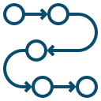
Highlight what is Important
Users engage with technology to accomplish goals or to fulfill a need. I-ology will learn the motivations of the personas and build features that match their goals.
Donation Acceptance
Donations are the top KPI for the new website. The seamless integration with Blackbaud will make it effortless to donate. To further promote donations, a donation button will be visible throughout all web pages.
Event Calendar and Registration
Viewing and registering for signature and affiliate events will be friction-free and foster the donor pipeline.
Staged Content Workflow
I-ology will implement a configurable, multi-stage approval process that will enable various stakeholders to distribute and approve content updates.
14

Slide 15
How We Get There
A Solid & Strategic Process
15

Slide 16



Deploy Stable, Secure, and Scalable Technology
The redeveloped website will cement the foundation for all future functionality. I-ology’s recommended CMS and Hosting structure will allow the website to have:
Robust CMS for content, features, and customize integration.
No recurring licensing fees.
Proper security and controls (full site SSL certification*).
Scalable functionality and capacity.
Umbraco is a powerful and user-friendly open source CMS. It will provide the HonorHealth Foundation an interface that simplifies day-to-day content management activities while simultaneously enabling application development flexibility and sophistication needed for future customization.
Amazon Web Services (AWS) provides cost-effective and reliable cloud hosting. It will supply the scalability and security that this website will require. HonorHealth Foundation will be hosted within the I-ology - AWS instance, so the HonorHealth marketing team can focus on business and I-ology can focus on support & maintenance.
Allows for design flexibility.
Configuration with Google Analytics
Easy management of search engine optimization (SEO) best practices.
Complies with Americans with Disabilities Act (ADA) standards
*SSL certificate purchased by the client and implemented by I-ology.
16

Slide 17
Deliver Excellence through a Refined Methodology
Our iterative process results in a dynamic website that reflects your culture, values, and objectives.
1. Discovery
Accuracy, quality, and efficiency are critical for success. Discovery is essential to understand all aspects of the project.
2. Proof of Concept
A collaboration that initiates the creation of sitemaps, interactive designs, content strategy, and functional requirements.
3. Build
Iterative development where interactions and constant feedback are baked in to provide the partnership needed to meet project objectives.
4. Stabilize & Release
The completion of end-to-end testing and user acceptance testing initiates the go live deployment.
5. Continuous Improvement
A philosophy to ensure the ongoing success and includes optimization, enhancements, reporting, monitoring, and integrated strategies.
Build the
Feature(s)
Test and Validate
Design the
Feature(s)
Approved
Discovery
Proof of Concept
Start Build Iterations
Collect & Refine
Requirements
Stabilize & Release
Continuous Improvement
Not Approved
Adjust & Iterate
17

Slide 18

What Will It Take
Implementation & Investment
18

Slide 19
An Accelerated Implementation Plan
The digital roadmap serves as a timeline for upcoming and future work. The identified deadlines called out in Phase 1 will ensure that I-ology can meet a December 14th launch date.
2020
2021
OCT
NOV
DEC
JAN
FEB
MAR
MAY
APR
JUN
JUL
AUG
SEP
OCT
NOV
DEC
PHASE 1
Project Start*
Stabilization
14
RFP Decision
Discovery & Proof
of Concept
Build
Deploy**
PHASE 2
Discovery
Build
Deploy
Proof of Concept
Stabilize
PHASE 3
Discovery
Build
Deploy
Proof of Concept
Stabilize
CONTINUOUS ENHANCEMENTS
*Timelines assumes project start date no later than October 5, 2020
** Brand collateral received no later than November 13, 2020.
19
Notes:
CHRIS TO REVIEW AND FINALIZE

Slide 20
Mutual Investment in Website Redesign - Phase 1
The table below represents the investment for Phase 1 of the website redesign Project..
 | Hours | Market Value ($150/Hour) | Your Investment | I-ology In-Kind
Website Redevelopment Phase 1 | 520 hrs - 613 hrs | $92,000 | $50,000 | $42,000
Below are the recurring costs for Managed Hosting, as well as ongoing Support & Maintenance after the launch of the new website. Support & Maintenance includes required and/or requested technical support, as well as minor updates and enhancements to the new HonorHealth Foundation website.
 | Monthly Hours | Market Value ($150/Hour) | Your Investment | I-ology In-Kind
Support & Maintenance | 30 hrs | $4,500/month | $3,450/month | $1,050/month
Managed Hosting | N/A | $300/month | $150/month | $150/month
20

Slide 21
The Big Picture
Build for Today, Plan for the Future
21

Slide 22









We will Co-Create Engagement for All
I-ology will design for the Big Picture, yet build based on requirements for today. The rapid growth of technology has users seeking to digitally engage with organizations that provide a streamlined experience.
Collaboration will extend beyond Phase 1 to ensure that all aspects of your digital ecosystem are harmonized and deliver a fluid user experience across all applications and devices.
22

Slide 23



Building Your Digital Community
Event Manage-
Ment
(Phase 1)
Website
Donor Portal
(Phase 2)
Volunteer Services
(Phase 2)
Virtual Tours
(Phase 2)
23

Slide 24



Building Community with Donors
Planned Giving
Migrate and optimize Crescendo content and features to the new Umbraco CMS.
Donor Portal
I-ology will leverage the foundation constructed in Phase 1 to scale the platform into a secure portal that will empower existing and future donors.
View giving history
Quickly donate
Review and update upcoming payments
Manage and update profile information
Further engage with HonorHealth Foundation
24

Slide 25


Digitizing “In-Person” Experiences
A complete digital ecosystem serves all persona’s. This will be accomplished for HonorHealth Foundation through:
Virtual Tours
HonorHealth Foundation will be able to showcase HonorHealth campuses through lifelike virtual experiences.
Volunteer Engagement Features
Volunteers will be empowered through self-service, intuitive capabilities which will modernize workflows and reduce barriers.
User Generated Content
Leveraging built-in CMS capabilities, users will be able to easily submit content for review and publishing.
25

Slide 26
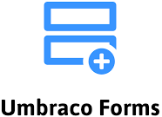
Engaging Your Digital Community
To draw engagement across digital platforms, future efforts will include:
Email Campaign Tool
Cloud email platforms are more than an email publishing tool. When utilized to their full potential, they create a 360 degree engagement experience.
Social Content Integration
Integration with social channels and content will create a transparent and complete digital experience. It connects digital assets and encourages cross platform engagement.
Digitized Forms
Umbraco’s built-in web form capability will enable HonorHealth Foundation to self service both simple or complex form requirements.
26

Slide 27
Supplemental Information / Vendor Question Responses
RFP Q&A
27

Slide 28
Supplemental Information / Vendor Question Responses
In order to ensure that we’ve thoroughly answered RFP questions & requests:
Sample Websites
Helios.org, SonoraQuest.com, OMLaw.com, OMLaunch.com, and JaburgWilk.com.
Healthcare Industry & Foundation Project Experience
I-ology has over 23 years of experience working with both the healthcare industry and the foundation/non-profit space including, but not limited to Sonora Quest Laboratories, Avella Pharmaceutical, Phoenix Health Plans, Abrazo Healthcare, Phoenix Children’s Hospital, Colorado Children’s Hospital, BHHS Legacy Foundation, Arizona Community Foundation, Special Olympics of Arizona, and Hospice of the Valley.
Outsourcing Versus Internal Staff
100% of client work is completed by the internal I-ology team.
Tracking Project Progress & Development Tools
  Jira - Project progress tracking.
  Clicktime - Project time tracking, project budget management, and resource capacity planning.
  Github - Source control storage.
  Visual Studio - Back-end development.
  VS Code - Front-end development.
28

Slide 29
Supplemental Information / Vendor Question Responses
What does your build process look like?
Will you create custom design or customize a ready made theme or template?
For Phase 1, we recommend augmenting a ready made theme from the CMS in order to accelerate the development process. A custom design could be considered for Phase 2 or 3.
Coding
Rolling/Official Build
Version control
Branch/packages
IDE & dev tools
Build verification
Unit testing
Check-in
Code Review
Local Build
Production Validation
E2E Validation
Select reviewers
Review
Check-in
Unit testing
Monitoring (Cloud watch & New Relic)
Pre-prod deploy
Scenario tests
Build drop
Insights
Pre-Check-in Validation
Deploy to Production
Private test env.
Functional tests
Static analysis
Deployment targets
29

Slide 30
Supplemental Information / Vendor Question Responses
What third-party apps do you typically integrate into your builds?
  AWS EC2 (Windows Server - IIS)
  AWS RDS (Microsoft SQL Server Database)
  AWS (Simple Email Service) Email Delivery & Smart Host)
  AWS Lambda (Serverless Functions)
  Twilio (SMS Delivery)
  SQL Server (Database)
  For front-end UI development I-ology has standardized on the vue.js (javascript platform) which builds into CSS & HTML5
  For back-end development and integration I-ology has standardized on .Net
  NewtonSoft (JSON Management)
What specific CMS do you use and recommend for this project?
I-ology is recommending that the website is built using the Umbraco 8.x CMS.
Describe the pre-launch testing/QA actions before you go live.
System Testing
Functional Testing
Client Validation/UAT
Go / No Go Decision
Deploy
30

Slide 31
Supplemental Information / Vendor Question Responses
Who will be working on the project, what role do they have, and what portion of their time will be devoted to the project?
  Project Owner 25%
  Project Manager 50% - 60%
  Business Analyst/Quality Assurance 25% - 50%
  Front-End Developer 90%
  Senior .Net Developer 75%
What we need from HonorHealth Foundation to ensure project success.
  Designated Project/Product Owner
  Designated Project Coordinator
  Subject Matter Experts
  Timely delivery of branding assets
31

Slide 32
Thank you!
Proposal Contact:
Trish Bear, CEO/President
tbear@i-ology.com
Cell: 602.570.2524

